Slide 1
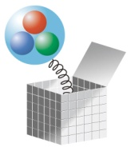
Spontaneous chiral symmetry breaking on the lattice
Shoji Hashimoto (KEK)
@ Chiral Dynamics 09 (Bern), Jul 6, 2009.

Slide 2
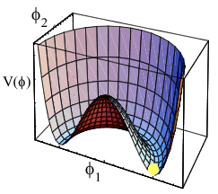
Chiral symmetry breaking
QCD Lagrangian
Chiral effective theory
GMOR relation, Goldberger-Treiman relation, Weinberg sum rule, soft pion theorem, chiral log, strange quark content, U(1) problem, θ vacuum, …
Spontaneous chiral symmetry breaking

Slide 3
Chiral symmetry is the key
chiral symmetry
non-singlet
singlet
Index theorem
Spontaneous symmetry breaking
Banks-Casher relation
topology
zero mode
Pion = Nambu-Goldston boson
instanton
GMOR relation
soft pion theorem
U(1) problem
Chiral log
Weinberg sum- rule
Θ vacuum
strange quark content
Goldberger-Trieman relation

Slide 4
Chiral symmetry on the lattice
Lattice QCD (with the Wilson-type fermions):
Chiral symmetry is explicitly violated (Nielsen-Ninomiya, 1981)
Not clear how to discriminate between physics and artifacts
e.g. chiral condensate: additive renormalization exists. Hard to subtract the power divergence.
staggered fermion has chiral symmetry, but breaks flavor symmetry.
Might not be in the same universality class; needs careful continuum limit.
Needs the rooted determinant (det D)^{1/2}

Slide 5
Chiral condensate
Order parameter of the chiral symmetry
direct prove of SSB
Not easy to calculate even with exact chiral symmetry
Power divergence persists except in the massless limit; makes sense only in the chiral limit
Thermodynamical limit: No SSB at finite volume; vanishes unless measured in the infinite volume limit
Need some theoretical guidance; provided by ChPT

Slide 6
This talk
= an attempt to simulate the QCD vacuum on the lattice with exact chiral symmetry
Overlap fermion (Neuberger, Narayanan, 1998)
Chiral and flavor symmetries are exact at finite lattice spacing a
Correctly reproduces the axial-anomaly (and the index theorem)
Study of spontaneous chiral symmetry breaking
Precise calculation of chiral condensate
spectral density + topological susceptibility, GMOR, …
Testing the chiral effective theory beyond the tree level

Slide 7
Plan
Dirac spectrum and chiral symmetry breaking
ε-regime and p-regime
beyond the leading order
Lattice calculation of the Dirac spectrum
Setup (not in detail)
Results for the spectral density
Other consequences of SSB
Topological susceptibility
Vacuum polarization functions
Convergence of the chiral expansion (m_{π}, f_{π})
Conclusions

Slide 8
1. Dirac operator spectrum and chiral symmetry breaking

Slide 9
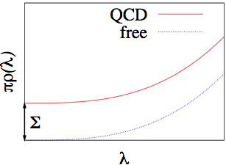
Banks-Casher relation
Bose-Einstein condensation in the QCD vacuum
Spectral density of the Dirac operator carries the info of the spontaneous symmetry breaking.
Banks-Casher (1980)
SSB
free quark
Also possible to study the relation at finite λ, V and m.
finite λ at NLO(p): Smilga-Stern (1993).
finite λ and m at NLO(p): Osborn-Toublan-Verbaarschot (1999).
finite V and small λ and m at NLO(ε): Damgaard-Nishigaki (1998).

Slide 10
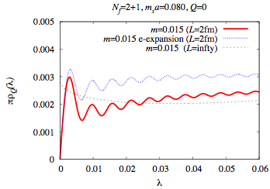
SSB on the lattice
Symmetry breaking occurs only in the infinite volume.
Need to study the finite volume scaling for a rigorous test.
Still possible to study on the finite volume lattice with the help of ChPT.
Beyond the leading order
New formula valid in both the p- (m_{π}L >1) and the ε-regime (m_{π}L <1), and in between.
Damgaard-Fukaya, JHEP 0901, 052 (2009).
zero mode integral done even in the p-regime
Damgaard-Fukaya (2009)
ex) m_{π}~300 MeV, L~2fm
ε-regime calc
infinite volume (NLO)
finite volume (NLO)

Slide 11
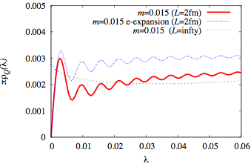
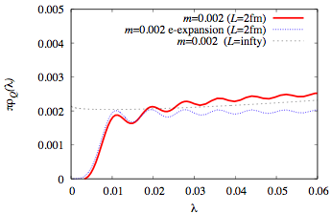
Expectation
Once we could calculate the spectral density on a finite volume lattice (L ~ 2 fm) …
Height determines Σ at the NLO accuracy
Shape is related to the NLO effects ~ 1/F²
p-regime: m_{π} ~ 300 MeV
ε-regime: m_{π} ~ 100 MeV

Slide 12
2. Lattice setup (not in detail)

Slide 13
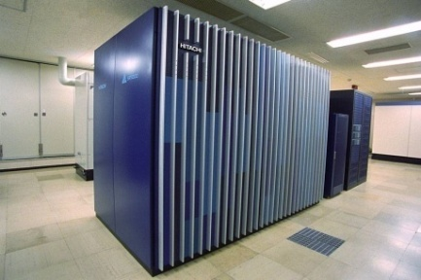
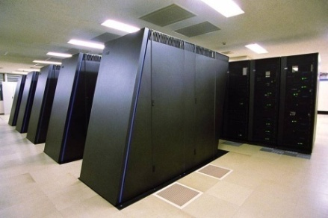
JLQCD+TWQCD collaborations
JLQCD
SH, H. Ikeda, T. Kaneko, H. Matsufuru, J. Noaki, N. Yamada (KEK)
H. Fukaya (Nagoya)
T. Onogi, E. Shintani (Osaka)
H. Ohki (Kyoto)
S. Aoki, N. Ishizuka, K. Kanaya, Y. Kuramashi, K. Takeda, Y. Taniguchi, A. Ukawa, T. Yoshie (Tsukuba)
K. Ishikawa, M. Okawa (Hiroshima)
TWQCD
T.W. Chiu, T.H. Hsieh, K. Ogawa (National Taiwan Univ)
Machines at KEK (since 2006)
SR11000 (2.15 Tflops)
BlueGene/L (10 racks, 57.3 Tflops)

Slide 14
Project: dynamical overlap fermions
First large scale simulation with exact chiral symmetry

Slide 15
Publications from the project
Not including conference proceedings
Fukaya et al. “Lattice gauge action suppressing near-zero modes,” Phys. Rev. D, 094505 (2006).
Fukaya et al. “Two-flavor QCD simulation in the ε-regime…,” Phys. Rev. Lett 98, 172001 (2007).
Fukaya et al. “Two-flavor lattice QCD in the ε-regime…,” Phys. Rev. D76, 054503 (2007).
Aoki, Fukaya, SH, Onogi, “Finite volume QCD at fixed topological charge,” Phys. Rev. D76, 054508 (2007).
Aoki et al., “Topological susceptibility in two-flavor QCD…,” Phys. Lett. B665, 294 (2008).
Fukaya et al., “Lattice study of meson correlators in the ε-regime…,” Phys. Rev. D77, 074503 (2008).
Aoki et al. “B_{K} with two flavors of dynamical overlap fermions,” Phys. Rev. D77, 094503 (2008).
Aoki et al. “Two-flavor QCD simulation with exact chiral symmetry,” Phys. Rev. D 78, 014508 (2008); arXiv:0803.3197 [hep-lat].
Noaki et al. “Convergence of the chiral expansion…,” Phys. Rev. Lett. 101, 202004 (2008); arXiv:0806.0894 [hep-lat].
Shintani et al. “S-parameter and pseudo NG boson mass…,” Phys. Rev. Lett. 101, 242001 (2008); arXiv:0806.4222 [hep-lat].
Ohki et al., “Nucleon sigma term and strange quark content…,” Phys. Rev. D 78, 054502 (2008); arXiv:0806.4744 [hep-lat] .
Shintani et al., “Lattice study of the vacuum plarization functions and …,” Phys. Rev. D 79, 074510 (2009); arXiv:0807.0556 [hep-lat].
S. Aoki et al., “Pion form factors from two-flavor lattice QCD with exact chira symmetry,” arXiv:0905.2465 [hep-lat].

Slide 16
Overlap fermion
Neuberger-Narayanan (1998)
constructed with the Wilson fermion as a kernel
Exact chiral symmetry through the Ginsparg-Wilson relation.
Continuum-like Ward-Takahashi identities hold.
Index theorem (relation to topology) satisfied.
Topology change is costly; large-scale simulation is feasible only at fixed topology
induces O(1/V) effects in general
No problem for the spectral function analysis

Slide 17
Parameters
N_{f} = 2 runs
β=2.30 (Iwasaki), a=0.12 fm, 16³x32
6 sea quark masses covering m_{s}/6~m_{s}
Q=0 sector only, except for Q=−2, −4 runs at m_{q}=0.050
ε-regime run at m=0.002 (m_{q}~ 3 MeV), β=2.30
N_{f} = 2+1 runs
β=2.30 (Iwasaki), a=0.11 fm, 16³x48
5 ud quark masses, covering m_{s}/6~m_{s}
x 2 s quark masses
Q=0 sector only, except for Q=1 at m_{ud}=0.015
Larger volume lattice 24³x48 running at m_{ud}=0.015, 0.025.
ε-regime run at m=0.002 (m_{q} ~ 3 MeV)

Slide 18
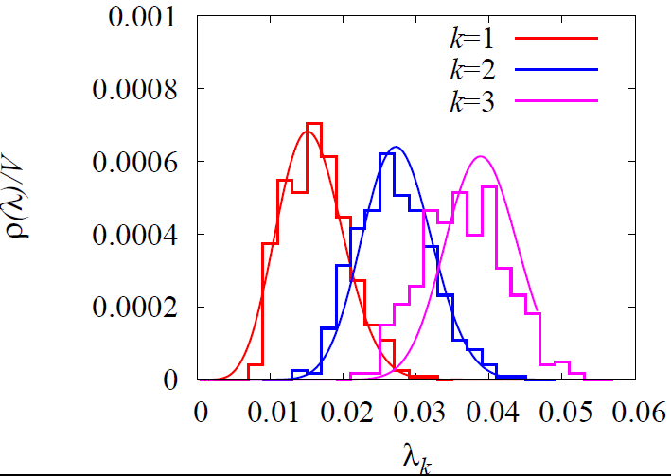
Early analysis (~2007)
N_{f}=2 in the ε-regime
low-mode distribution compared with the Random Matrix Theory (RMT) to extract Σ.
Valid for small enough λ ∼ 1/ΣV
Limitations
Controlled finite volume effects?
p-regime lattice not useful
Not possible to extend RMT to NLO
JLQCD, Phys. Rev. Lett 98, 172001 (2007)
Σ(2 GeV) = [ 251(7)(11) MeV]³
Can overcome with the new ChPT formulae.

Slide 19
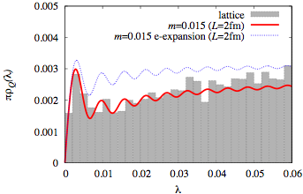
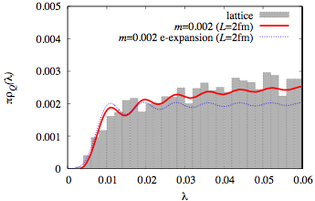
New analysis (2009)
p-regime
Direct use of the spectral function
2+1-flavor data
Uses both the p-regime and ε-regime lattices.
Fit the whole shape against the ChPT formula.
Comparison
NLO formula reproduces the lattice data precisely.
The previous ε-regime formula was useful only for the 1st eigenvalue in the p-regime.
ε-regime

Slide 20
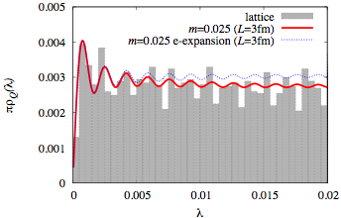
New analysis (2009)
Finite volume effect
Checked with a larger volume data on a 24³x48 lattice (L ~ 2.6 fm)
Can be fitted with the same set of parameters as in the 16³x48 analysis.
ρ(λ) slightly going down after the first peak = pion-loop effect in the p-regime.
Finite volume effect well under control.
24³x48

Slide 21
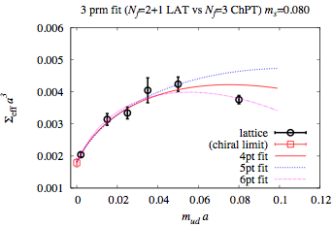
Chiral extrapolation
Lattice data at 6 values of m_{ud} including the ε-regime
Massless limit of up-down, while keeping strange quark mass at its physical value.
Chiral log
well reproduced by the lattice data.
Fit is done with N_{f}=2 and with N_{f}=2+1 formulae.
Determination of Σ and F, L₆
p-regime
ε-regime
JLQCD (2009); preliminary

Slide 22
3. Other consequences of SSB

Slide 23
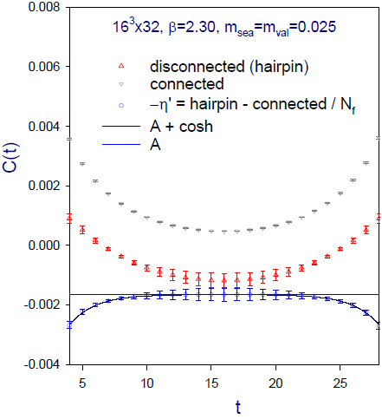
Topological susceptibility χ_{t}=⟨Q²⟩/V
Other Consequences of SSB (1)
Correlation of the topological charge density at fixed Q
~ constant proportional to χ_{t}
N_{f}=2 example
JLQCD, Phys. Lett. B665, 294 (2008)
(negative) constant correlation of the local topological charges clearly seen.
Results from other topological sectors are consistent.
Higher order correction (~1/V²) also estimated using 4-point corr.

Slide 24
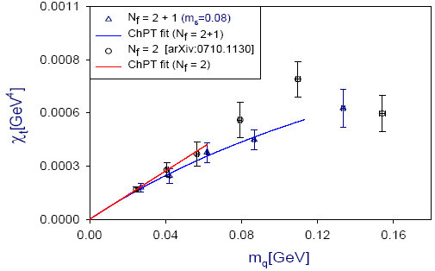
Sea quark mass dependence
The effect of SSB = vanishing towards the chiral limit
Fit with ChPT expectation
N_{f}=2:
Σ = [242(5)(10) MeV]3
N_{f}=2+1:
Σ = [247(3)(2) MeV]3
Crewther (1977), Leutwyler-Smilga (1992)
N_{f}=2
N_{f}=2+1
JLQCD (2009): N_{f}=2 and 2+1
Disconnected loops constructed from low modes (saturation confirmed).

Slide 25
Vacuum polarization functions
Other Consequences of SSB (2)
Vector and axial correlators in the momentum space.
Directly calculable on the lattice for space-like momenta
Weinberg sum rules:
Vanishes when V=A; another probe of SSB
S is relevant for the precision EW test of new strong dynamics.

Slide 26
Pion electromagnetic mass splitting
Das-Guralnik-Mathur-Low-Young sum rule (1967)
Valid in the chiral limit (soft pion theorem)
Gives dominant contribution to the π±-π⁰ splitting.
Related to the pseudo-NG boson mass in the context of new strong dynamics.
Exact chiral symmetry is essential.
The quantity of interest is obtained after huge cancellation between V and A.

Slide 27
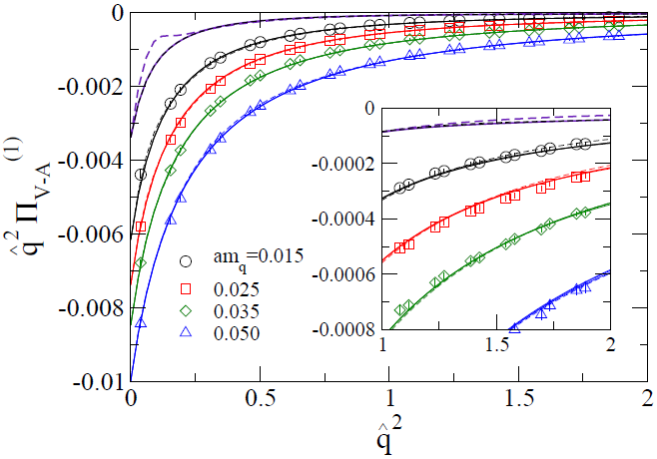
Lattice results
Can be fitted with
ChPT in the low q² region
L₁₀ is extracted.
OPE in the high q² region. In the massless limit, 1/Q⁶ is the leading.
Summing up the two regions, Δm_{π}² is obtained.
JLQCD, Phys. Rev. Lett. 101, 242001 (2008)
N_{f}=2

Slide 28
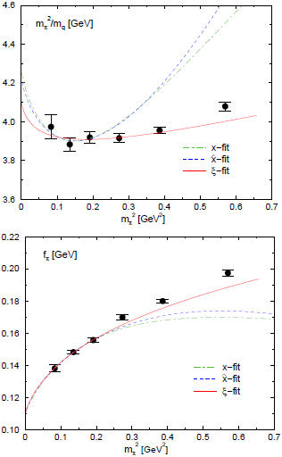
Pion mass & decay constant
Other Consequences of SSB (3)
Phys. Rev. Lett. 101, 202004 (2008)
Precise test of GMOR
Chiral expansion
The region of convergence is not known a priori.
Test on the lattice with exact chiral symmetry
Expand in either
N_{f}=2
ξ-expansion

Slide 29
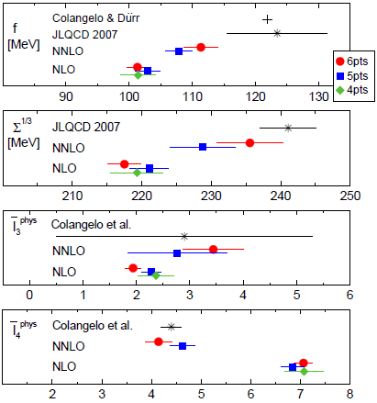
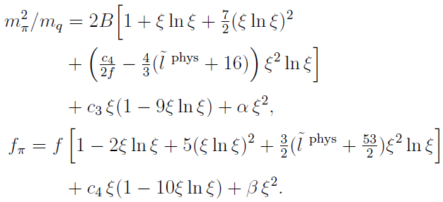
Two-loop analysis
Analysis including NNLO
With the ξ-expansion
For reliable extraction of the low energy constants, the NNLO terms are mandatory.

Slide 30
Conclusions
The spontaneous chiral symmetry breaking of QCD is confirmed by simulations with exact chiral symmetry.
Beyond LO; finite volume, chiral limit well under control.
Other consequences: topological susceptibility, Weinberg sum rules, GMOR, …
Overlap simulations open up new possibilities to extract physics from lattice.
At last, lattice QCD has followed up the various theoretical conjectures for strong interaction in 1960s and 70s. But now from first-principles.

Slide 31
Thank you for your attention!

Slide 32
Backup slides

Slide 33
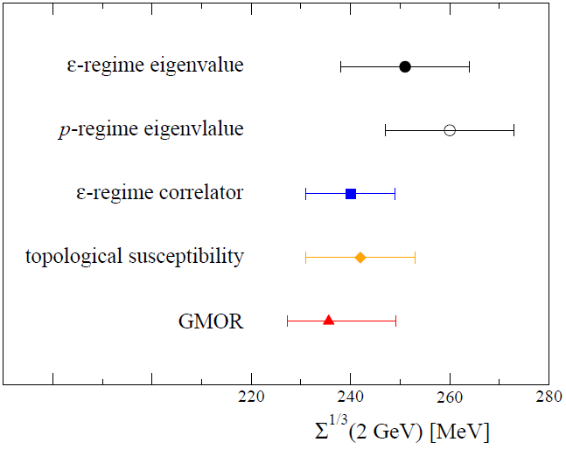
Two-flavor condensate
Phys. Rev. Lett 98, 172001 (2007)
Phys. Rev. D76, 054503 (2007)
Phys. Rev. D77, 074503 (2008)
Phys. Lett. B665, 294 (2008)
Phys. Rev. Lett. 101, 202004 (2008)
In good agreement

Slide 34
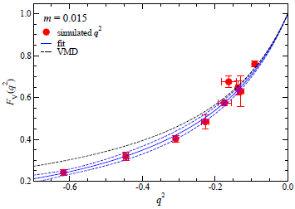
Pion form factors
Another testing ground of ChPT
Vector and scalar
Charge and scalar radius
Calculation using the all-to-all technique.
Vector form factor
q² dependence well described by a vector meson pole + corrections.

Slide 35
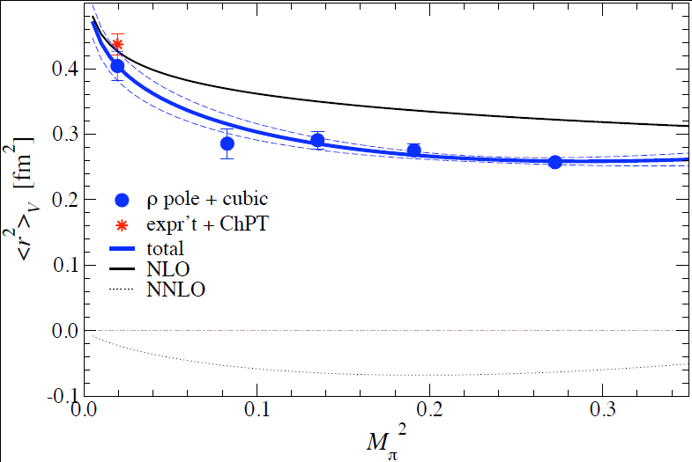
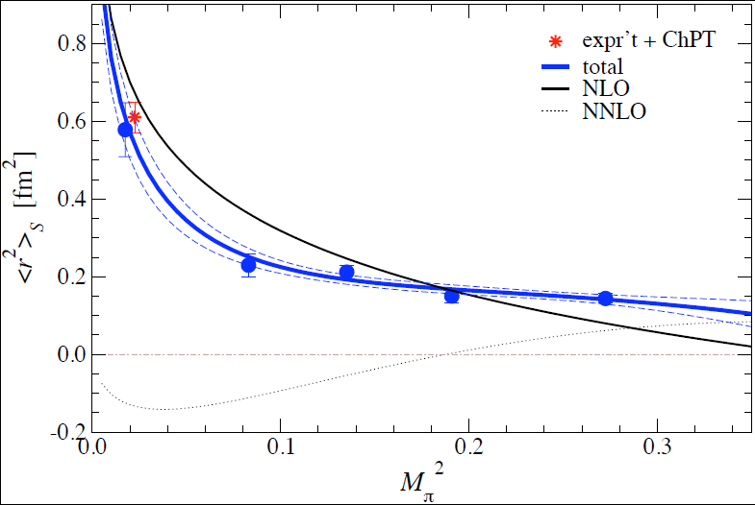
Chiral extrapolation
Fit with NNLO ChPT
Data do not show clear evidence of the chiral log. But, it is expected to show up even smaller pion masses.
NNLO contribution is significant; necessary to reproduce the phenomenological values.

