Slide 1

Evgeny Epelbaum
Chiral Dynamics 2009, Bern, 09.07.2009
Effective Theory for Nuclear Forces
Evgeny Epelbaum, FZ Jülich & Uni Bonn
Outline
Introduction
ERE, MERE and LETs
„Chiral“ EFT for a solvable toy model
A more realistic case
Summary
In collaboration with Jambul Gegelia
TexPoint fonts used in EMF.
Read the TexPoint manual before you delete this box.: AAAAAAAAAAA

Slide 2




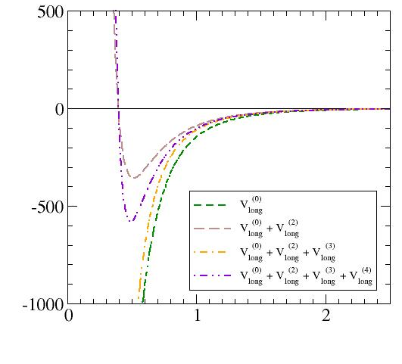










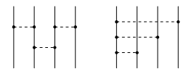
Introduction I
Goldstone-boson and single-nucleon sectors: weakly interacting systems ChPT
Two and more nucleons: strongly interacting systems
Hierarchy of scales for non-relativistic ( ) nucleons:
π-less EFT with local few-N interactions
← talk by Lucas Platter
chiral EFT (cf. pNRQCD), instantaneous (nonlocal) potentials due to exchange of multiple Goldstone bosons rigorously derivable in ChPT
Weinberg ‘91,’92
Two-nucleon force
Three-nucleon force
Four-nucleon force
zero-range operators
LO
internucleon potential [MeV]
chiral expansion of
multi-pion exchange
NLO
N²LO
separation between the nucleons [fm]
N³LO
see E.E., Hammer, Meißner, arXiv:0811.1338, Rev. Mod. Phys., in press

Slide 3



Introduction II
Can long-range physics due to pion exchange be treated in perturbation theory (KSW)?
Potential pion ladder diagrams generate large terms which are nonanalytic in p² and lead to breakdown of perturbation theory in some channels
Fleming, Mehen, Stewart ’00; also Cohen, Hansen ’99; Gegelia’99; …
Explicit results for box graph available in: Kaiser, Brockmann, Weise, NPA625 (1997) 758
it seems necessary to treat pions non-perturbatively at
see, however, Beane, Kaplan, Vuorinen, arXiv:0812.3938 for an alternative scenario
Nonperturbative resummation via solving the Schrödinger (Lippmann-Schwinger) equation
Weinberg ‘91,’92
, grow with increasing momenta LS equation needs to be regularized and renormalized
Regularization of the LS equation
DR difficult to implement numerically due to appearance of power-law divergences, Phillips et al.’00
Cutoff (employed in most applications)
— needs to be chosen to avoid large artifacts (i.e. large -terms)
— can be employed at the level of Lagrangian in order to preserve all relevant symmetries
Slavnov ’71; Djukanovic et al. ’05,’07; also Donoghue, Holstein, Borasoy ’98,’99
— just regularized diagrams do not obey dimensional power counting (contrary to e.g. DR)

Slide 4
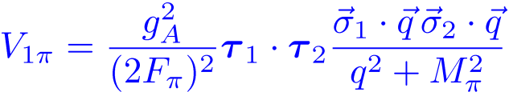








Introduction III
How to renormalize the Schrödinger equation?
← Lepage, arXiv: nucl-th/9706029; also talk at the INT
program “EFT and effective interactions”, Seattle, Aug. 2000
times iterated OPEP infinitely many counter terms needed in the Born series
Born series with LO potential non-renormalizable (in the usual sense)
Renormalization à la Lepage
Ordonez et al.’96; Park et al.’99; E.E. et al.’00,’04,’05; Entem, Machleidt ’02,’03
Choose & tune the strengths of short-range operators to low-energy observables.
generally, can only be done numerically; requires solving nonlinear equations for ,
self-consistency checks via „Lepage plots“,
residual dependence in observables survives
Nonperturbative renormalization of the Lippmann-Schwinger equation:
Frederico et al.’99,’05; Valderrama, Arriola ‘04-08; Higa et al.’08; Yang et al.’08,09
Same as above but with or even
manifestly nonperturbative,
untunable in some channels,
the number of short-range operators dictated by the strongest small- singularity in
Mixed approach
Beane et al.’’02; Nogga et al.’05; Long, van Kolck’08; Birse ’05,’07
Perturbative treatment of some parts of the potential and/or some partial waves
← talk by Mike Birse
Studying E(F)T for solvable models may provide helpful insights on renormalization
in the nonperturbative environment…

Slide 5
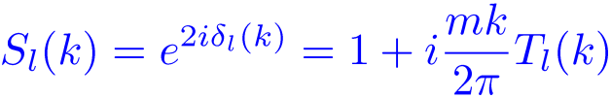
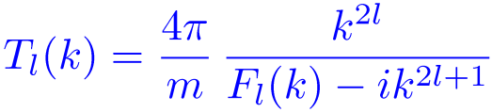
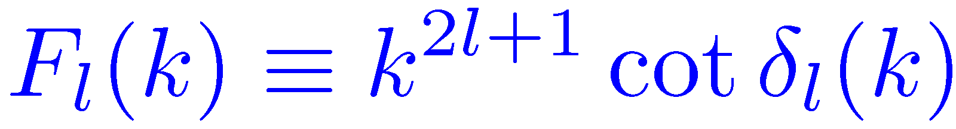




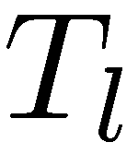

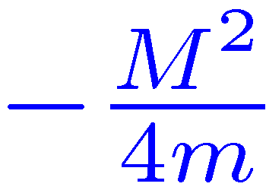


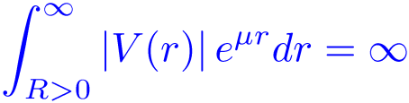
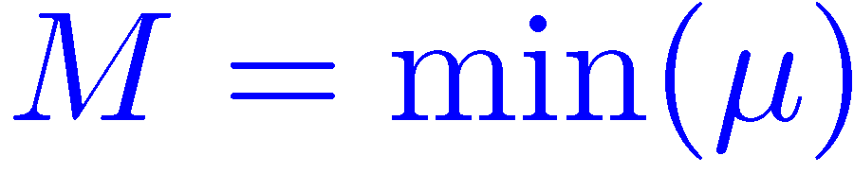
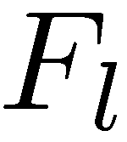

Effective Range Expansion
Blatt, Jackson ’49; Bethe ‘49
Nonrelativistic nucleon-nucleon scattering (uncoupled case):
effective-range function
where
and
If satisfies certain conditions, is a meromorphic function of near the origin
effective range expansion (ERE):
The range of convergence of the ERE depends on the range of defined as
such that
Both ERE & π-EFT provide an expansion of NN observables in powers of , have the same validity range and incorporate the same physics
ERE ~ π-EFT (in the NN sector)

Slide 6
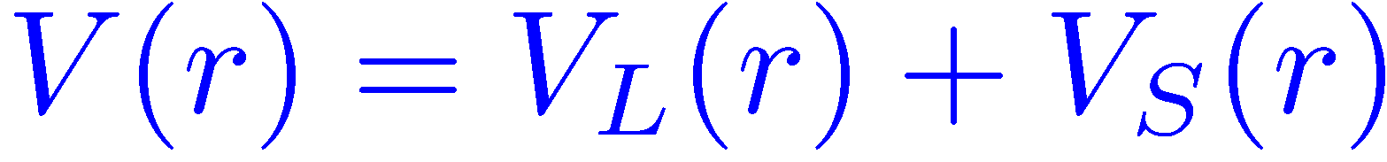
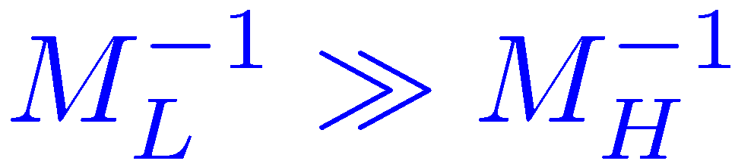
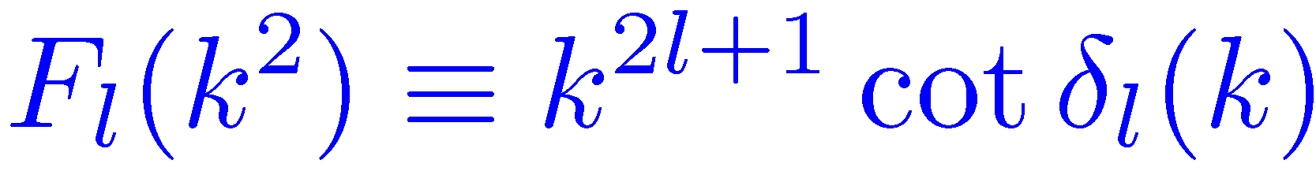
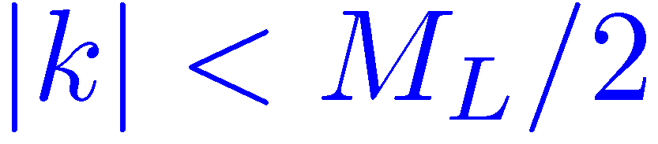
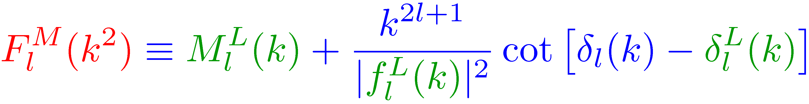
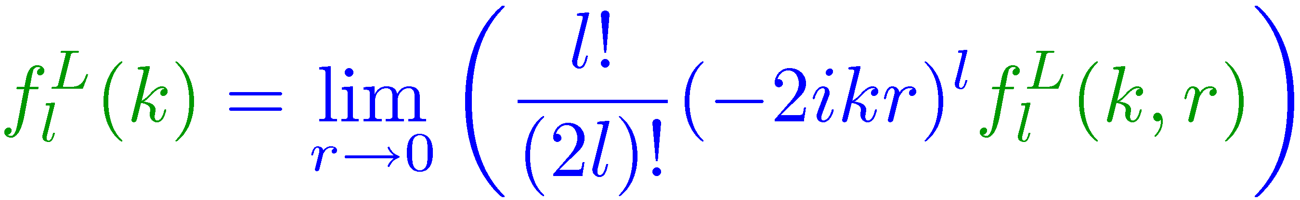
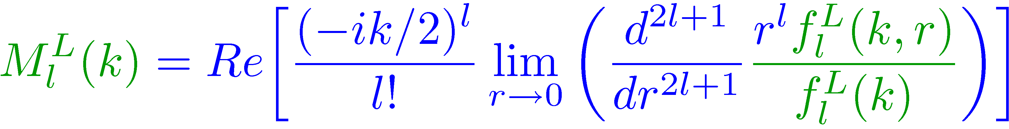




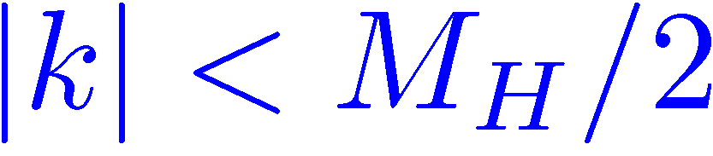



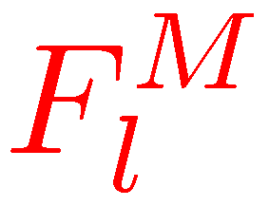


Modified Effective Range Expansion
van Haeringen, Kok ‘82
Consider the two-range potential where
the ER function is meromorphic in the region
The modified ER function is defined as:
where
and
Jost function for
Jost solution for
Per construction, the MER function
reduces to if
is a meromorphic function of for
Notice:
for to exist, has to fulfill certain constraints at small
for , reduces to the usual Coulomb-modified ER function
MERE has also been applied to chiral potentials
Steele, Furnstahl ’99,‘00; Birse, McGovern ‘04

Slide 7




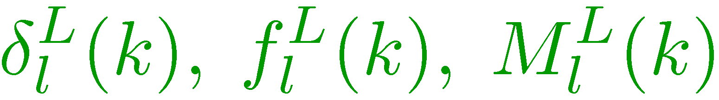

MERE and Low-Energy Theorems
Long-range interactions imply existence of correlations between the ER coefficients
low energy theorems Cohen, Hansen ’99; Steele, Furnstahl ‘00
where
depend on and quantities calculable from
and
Use the „long-range quantities“ calculable from and the first coefficients in the MERE for as input
reproduce the first ERE coefficients and make predictions for all the higher ones
Well-defined power counting for observables based on NDA if one knows
At low energy, the above correlations are the only signatures of the long-range force

Slide 8

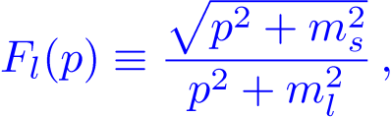
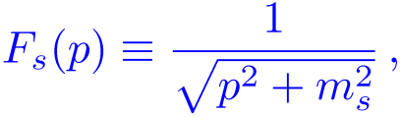


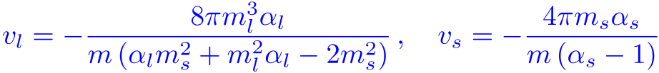

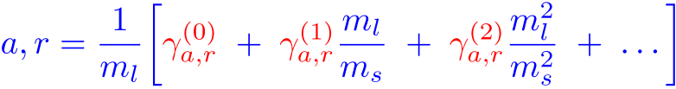
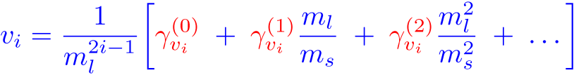

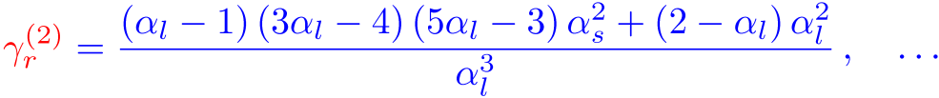
Toy model
E.E., J. Gegelia, arXiv:0906.3822, EPJA in press
Two-range ( ) spin-less separable model:
with
“Natural” scattering lengths with
and
(strong long-range and weak short-range interactions at momenta )
“Chiral” expansion of the coefficients in the ERE (S-wave):
and
depend on the details of the interaction
Scattering length:
Effective range:

Slide 9

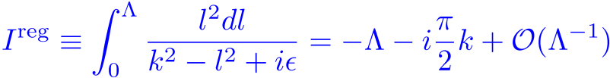

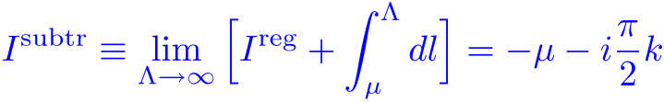



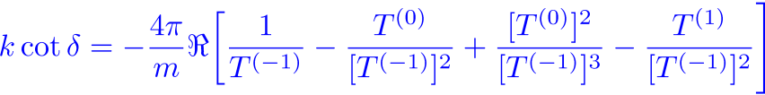



















Low-energy theorems à la KSW
Effective theory:
KSW-like approach:
use subtractive renormalization that maintains the power counting at the level of diagrams and keep track of the soft scales
Example of subtractive renormalization
Q-expansion of the amplitude up to NNLO
Effective range function up to NNLO
← use some ‘s to fix the integration constants
LO: pure long-range interaction, and correctly reproduced for ∀i
NLO: use as input to fix and predict also and for ∀i
NNLO: use as input to fix and predict also and for ∀i

Slide 10







Low-energy theorems à la Weinberg
It is difficult to apply the above renormalization scheme to OPEP (non-separable) cutoff regularization and Lepage’s scheme
Lepage, arXiv: nucl-th/9706029
LO: same as before (only long-range force),
and correctly reproduced for ∀i
NLO:
Solve the LS equation for a given value of and adjust the LEC to reproduce the scattering length:
scatt. length in the underlying model
Prediction for the effective range:
The first nontrivial LET correctly reproduced provided one chooses . The second LET can be reproduced for specific value of the cutoff, . Same conclusions for the shape parameters .

Slide 11


Infinite cutoff limit
Prediction for the effective range:
Notice that the infinite cutoff limit does not commute with Taylor expansion of in powers of :
It is possible to take the limit for -matrix while keeping the scattering length correctly reproduced
cutoff-removed “nonperturbatively-renormalized” result for the effective range:
the first non-trivial LET is broken after taking the limit
Similarly, the LETs for the shape parameters are also broken in the infinite- limit.

Slide 12







Discussion
Breakdown of LETs in E(F)T calculations of that kind (i.e. based on solving the LS equation with a given “long-range” and a series of contact interactions) in the limit can easily be understood. In general:
set of dimension-less couling constants
The first (depending on the model/order of calculation) coefficients are “protected” by the analytic pro-perties of the amplitude (cf. MERE) once ‘s are appropriately tuned
However, higher “unprotected” coefficients in the “chiral” expansion do, in general, depend on . This dependence involves log’s and positive powers of since the potential is non-renormalizable (in the usual sense) choosing will spoil the LETs for the lower coefficients. The amplitude gets controlled by - and -terms which would be subtracted in the SR scheme
improper (for EFT) choice of renormalization conditions, cf. KSW-result with
Our results are in line with the recent (numerical) studies based on chiral potentials up to N²LO, see:
Yang, Elster, Phillips, PRC77 (2008) 014002; arXiv:0901.2663; arXiv:0905.4943

Slide 13


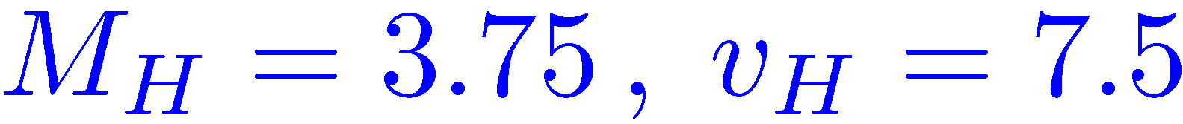
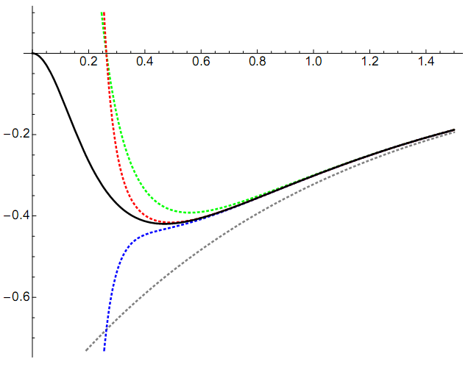
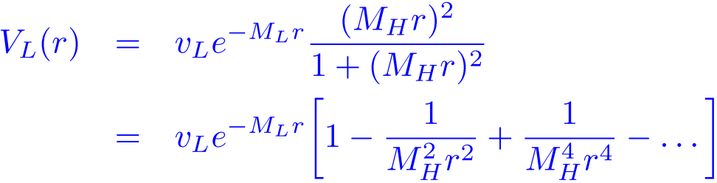


A more realistic model
Minossi, E.E., Nogga, Pavon Valderrama, in preparation
MERE allows for a well-defined power counting if the long-range interaction is exactly known.
Lepage’97, Steele, Furnstahl’99
zero-range operators
Chiral EFT yields the long-range NN force as a long-distance expansion, expected to converge for .
Finite-order approximations are singular at the origin.
internucleon potential [MeV]
chiral expansion of
multi-pion exchange
Toy model with expandable long-range interaction
with
long-range
short-range
separation between the nucleons [fm]
Parameters:
“Chiral” expansion of the long-range interaction:
r [fm]
singular cutoff
How do MERE coefficients scale for approximated ?
Found numerically the proper scaling (i.e. with powers of
) for the first MERE coefficients. The better approx. for
, the more coefficients scale properly.

Slide 14

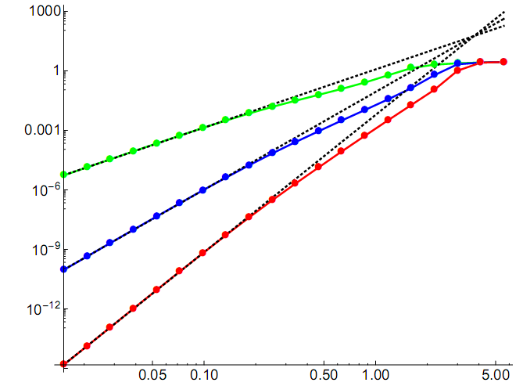
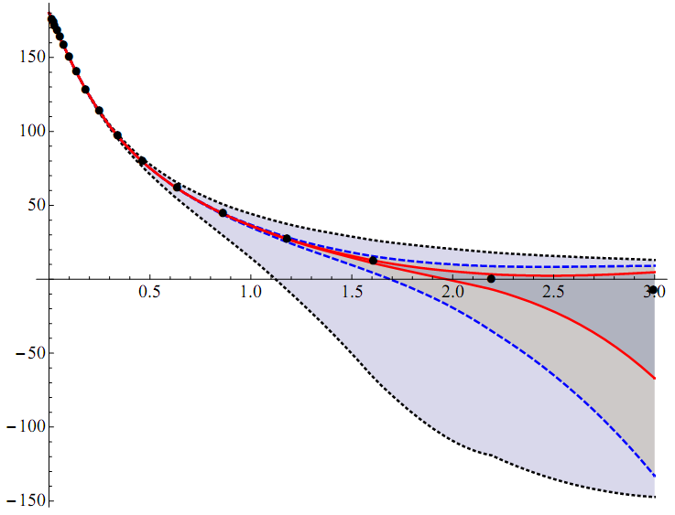



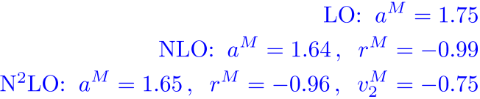

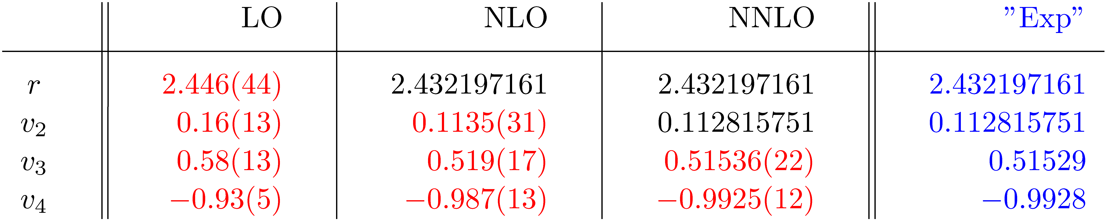
“Chiral” expansion for S-wave
Example of calculation based on the NNLO approximation of the long-range interaction and . First few coefficients in the MERE used as input. Error estimated by varying the next-higher coefficient in the MERE from -3 to +3 in units of .
Error plots for
Results for phase shift
Input parameters
ERE
ERE
low-energy theorems

Slide 15



Summary
Long-range forces imply correlations between the ERE coeff. low-energy theorems
The emergence of LETs in EFT for an exactly solvable model shown in the KSW scheme. LETs reproduced correctly in the W. approach if but broken for
(easy to understand using dimensional analysis — improper choice of renorm. conditions)
Removing by taking the limit may well yield finite result for the solution of the LS equation but does not qualify for a consistent renormalization in the EFT sense. It is only justified if all necessary counterterms are taken into account.
Weinberg‘s approach (i.e. iteration of the chiral potential in the LS equation) conceptually well-defined (in the sense of MERE, cf. toy models & Lepage, arXiv: nucl-th/9706029); more analytic insights needed to map χ-expansion of onto any kind of expansion for obser-vables power counting.
Some open questions (personal list)
Is the Nature kind enough to allow us treating (parts of the) pion exchange perturbatively?
What is the hard scale for chiral potentials (i.e. at what distance does the expansion of the long-range force start to diverge)?
Chiral expansion for short-range operators under control, cf. Mondejar, Soto ’07 ?

Slide 16
spares

Slide 17

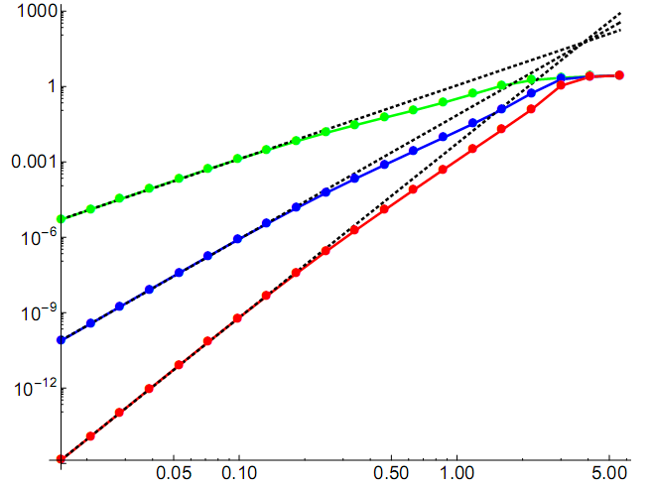
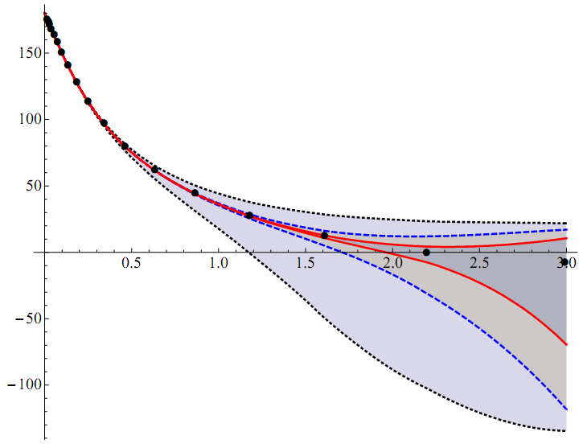
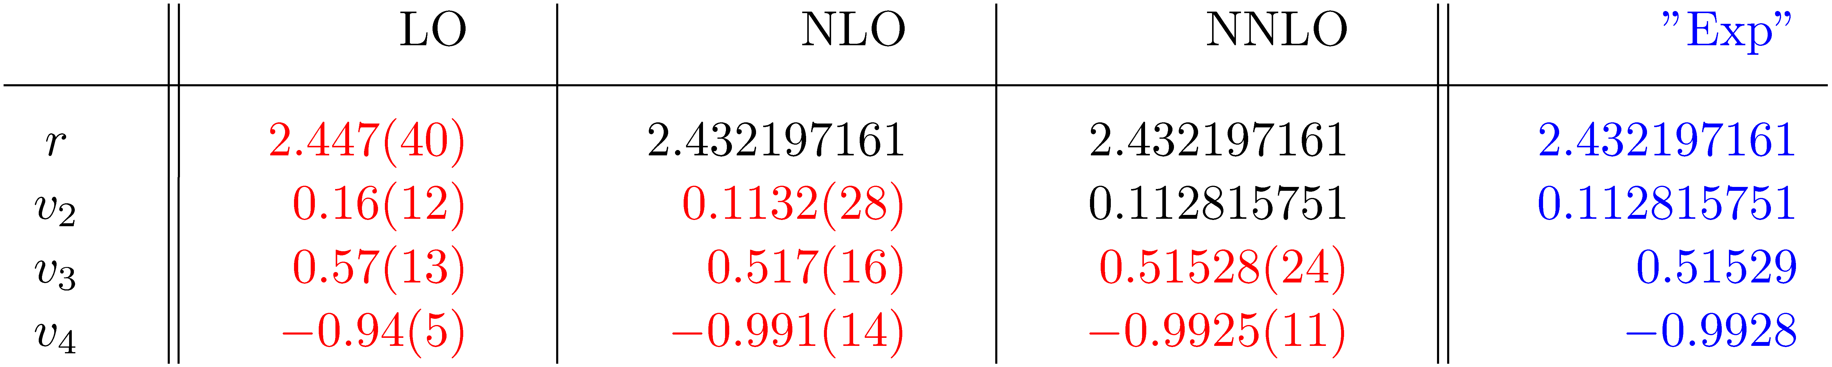
The same for a smaller cutoff
“low-energy theorems”

Slide 18

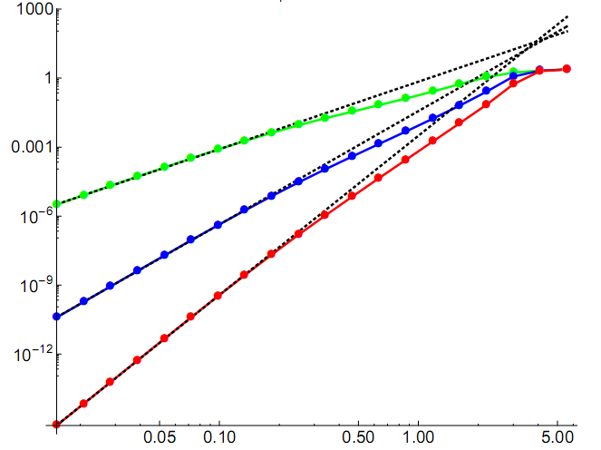
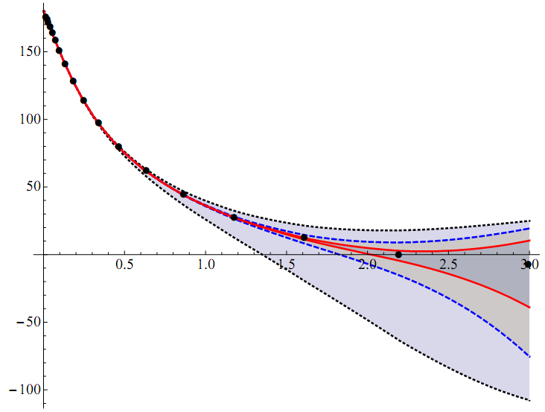
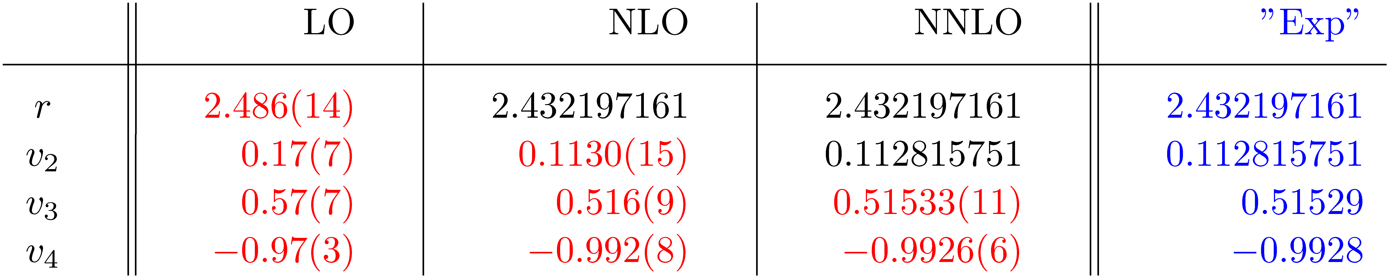
…and for an even smaller cutoff
“low-energy theorems”

Slide 19
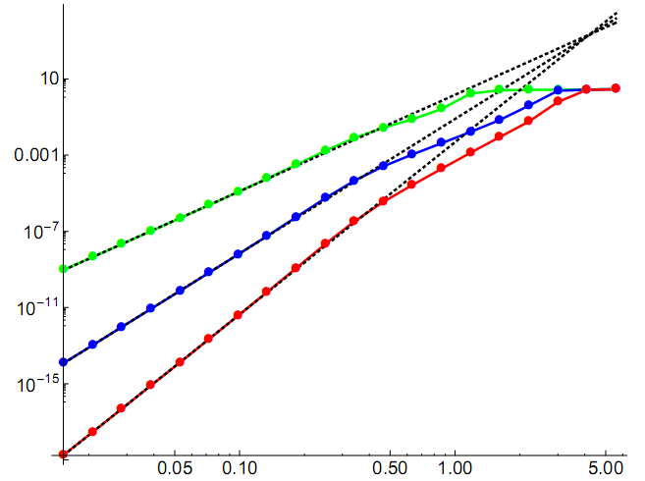
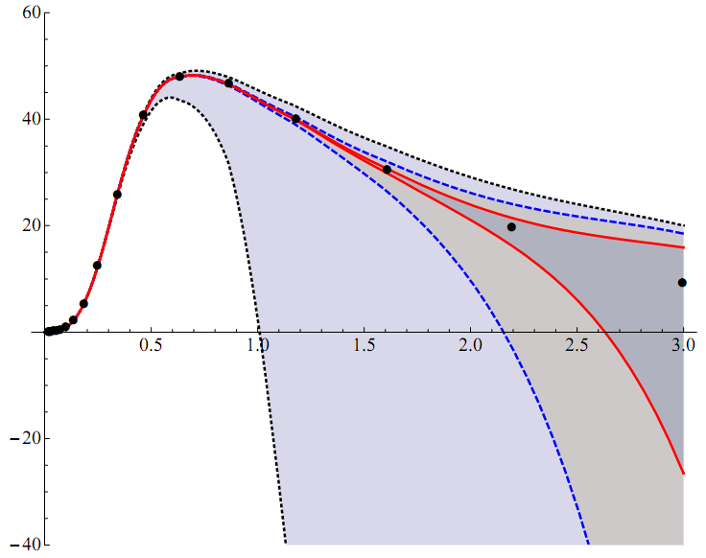
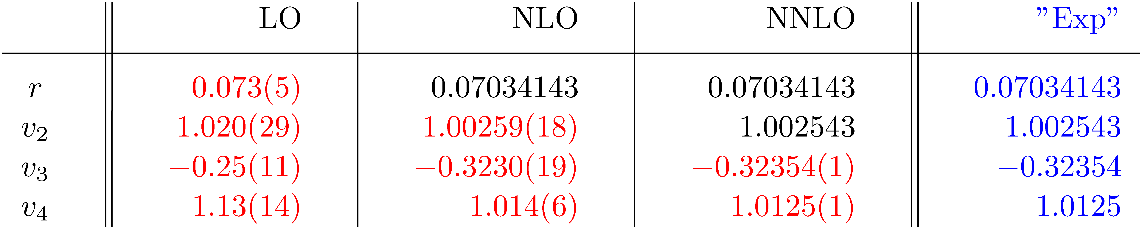
“Chiral” expansion for P-wave
Error plots for
Results for phase shift
ERE
ERE
low-energy theorems

Slide 20
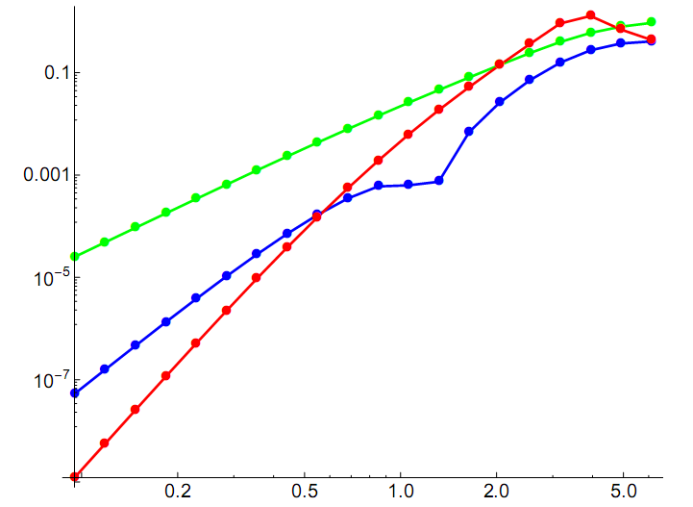
Too many contact terms without proper including the long-range physics may hurt…

Slide 21
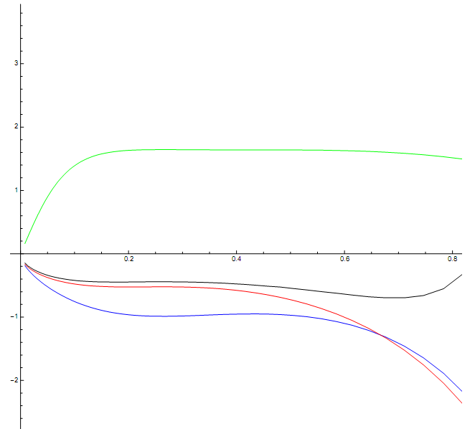

Slide 22
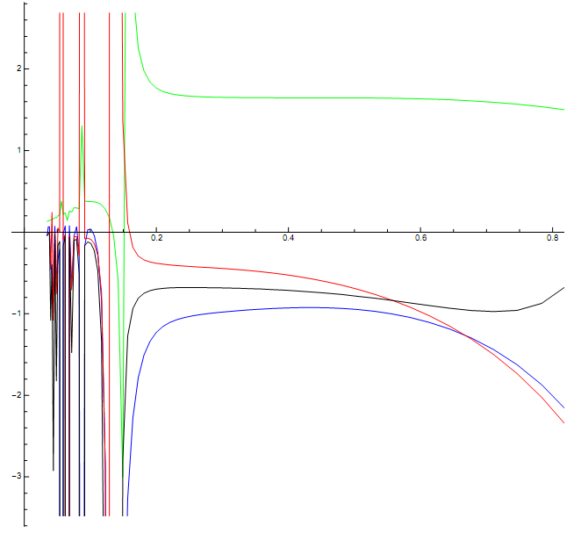

Slide 23
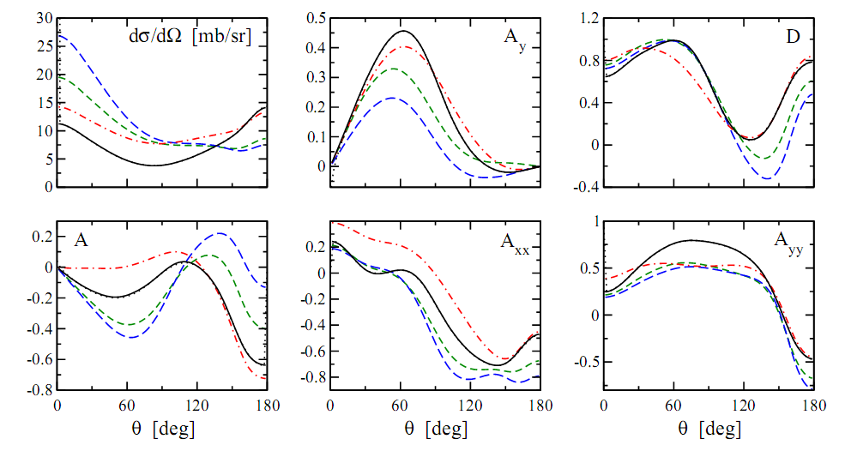

NN observables at 100 MeV: NTvK vs Weinberg

Slide 24



Evidence of the chiral 2π-exchange from Nijmegen PWA
Rentmeester, Timmermans et al.’99,‘03
Chiral 2π-exchange potential up to N²LO has been tested in an energy-dependent proton-proton partial-wave analysis
b
EM + [Nijm78; 1π; 1π+2π]
Energy-dependent boundary condition

Slide 25













Do existing NN data show any evidence for chiral 2π-exchange?
Low energy S-wave threshold parameters
S-wave threshold (effective range) expansion:
1.2%
3.0%
NLO
8%
10%
5%
¹S₀:
1.0%
2.2%
6%
0.7%
N²LO
5%
1.5%
N³LO
5%
2%
2%
1%
0.24%
2.5%
75%
21%
10%
³S₁:
0.13%
1.5%
13%
0.11%
5%
0.6%
25%
4%
2%
Values for a and r extracted from NPWA, de Swart, Terheggen & Stoks ’95;
v_{i} are based on NIJM-II, see also: Pavon Valderrama & Ruiz Arriola nucl-th/0407113.

